Slide 1
Joonggu Storyboard User App
문서 버전 | v.1.0
문서 구분 | 스토리보드
작성자 | 기획팀 | 확인자 | 이다훈

Slide 2
문서버전 | 작성자 | 담당자 | 주요 내용 | 비고
V.1.0 | 기획팀 |  | 최초 작성

Slide 3
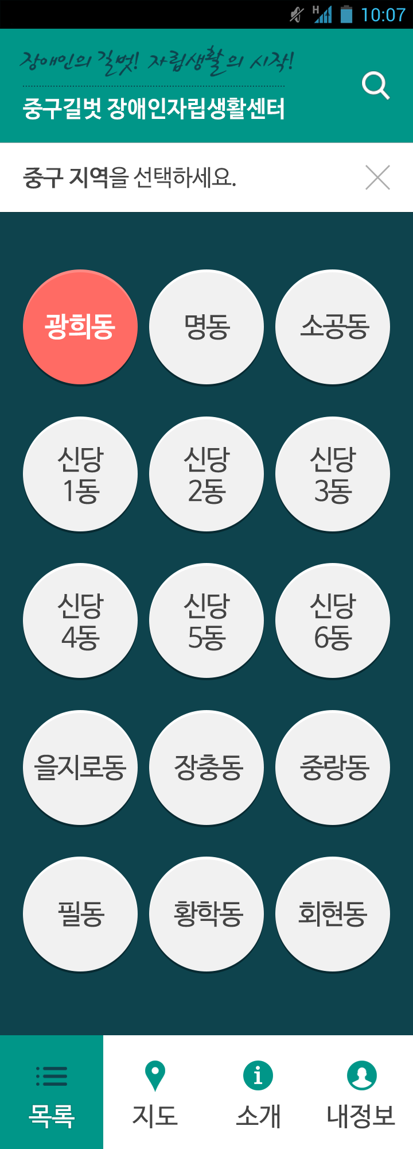
프로젝트명 | 중구길벗 | 페이지명 | area | 지역
생성자/수정자 | 기획팀 | 최초작성일 | 2015.08.29 | 최종수정일
1
Description
Automatic start with a list screen when starting the application - The search box opens at the Header when touched.(refer to [search]) - The rest of the parts below the Header remain when touched. - Major areas in Joonggu are divided and expressed as an icon. - Touching each icon allows user to see a list of companies in the relevant area. – [area_store] - Pictures with regional characteristics and icons with the name of each region The screen changes when touched.- [area] The screen changes when touched. - [map] The screen changes when touched. - [intro] The screen changes when touched. - [mypage]
2
3
4
5
6

Slide 4
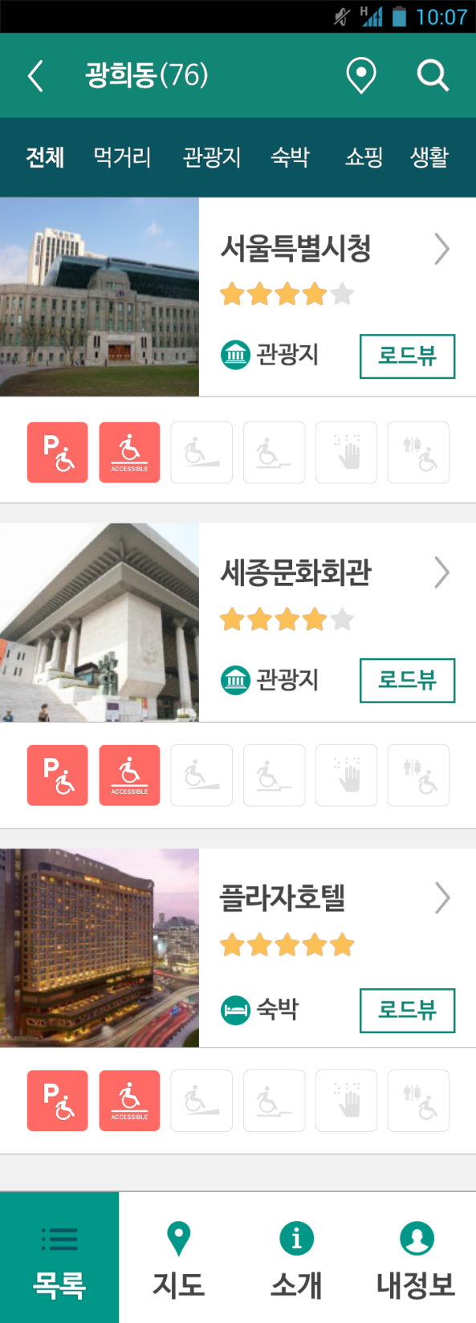
프로젝트명 | 중구길벗 | 페이지명 | area_store | 지역>업체
생성자/수정자 | 기획팀 | 최초작성일 | 2015.08.29 | 최종수정일
1
2
3
Description
It goes back when touched. – [area] - The name of a region selected on a region selection screen - The number of companies filtered and exposed at the relevant category are displayed in brackets. Map View button The companies currently being exposed are displayed on a map when touched. – [area_store_map] Category selection menu. Only the contents of the relevant category are displayed below when touched. - 전체 = all, 먹거리 = food, 관광지 = sight, 숙박 = accommodation, 쇼핑 = shopping, 생활 = living - The contents including accessibility information checked in the setting are displayed. (And concept) - A representative thumbnail image, the name, a category icon, a star-grade, and an accessibility information icon of each company are displayed. - Every area is clickable except Road View button. Touching each area shows the detailed information of the relevant company. – [area_store_detail1] Road View button - Touching this button runs Naver Map and shows the relevant pin selected on it. It is for activating Road View immediately after touching Road View button on the current screen. - In case of a device without Naver Map, it runs Google Play and sends a download screen to install Naver Map.
4
5
6
6
6

Slide 5
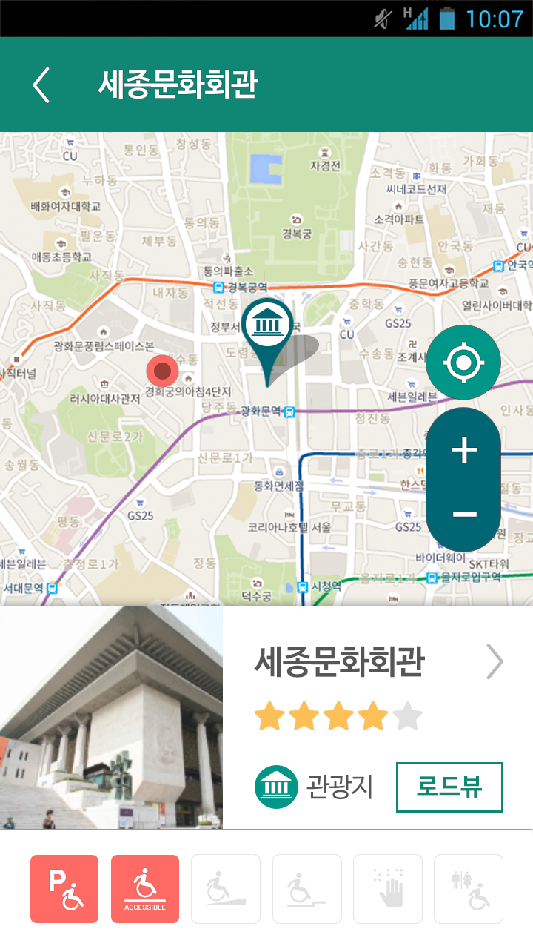
프로젝트명 | 중구길벗 | 페이지명 | area_store_map | 지역>업체>지도로 보기
생성자/수정자 | 기획팀 | 최초작성일 | 2015.08.29 | 최종수정일
1
2
Description
It goes back when touched. – [area_store] - The name of a region selected on a region selection screen - The number of companies displayed before touching Map View are displayed in brackets. Touching Map View adjusts the map to have all exposed companies displayed as a pin on one screen. Default is when the contents exposed at the top when touching Map View are selected. - Touching each pin displays a representative thumbnail image, the name, a category icon, a star-grade, and an accessibility information icon of each company at the bottom. - Default displays the contents exposed at the top when touching Map View. - Touching each area shows the detailed information of the relevant company. – [area_store_detail1] Road View button - Touching this button runs Naver Map and shows the relevant pin selected on it. It is for activating Road View immediately after touching Road View button on the current screen. - In case of a device without Naver Map, it runs Google Play and sends a download screen to install Naver Map.
3
4
5
6

Slide 6
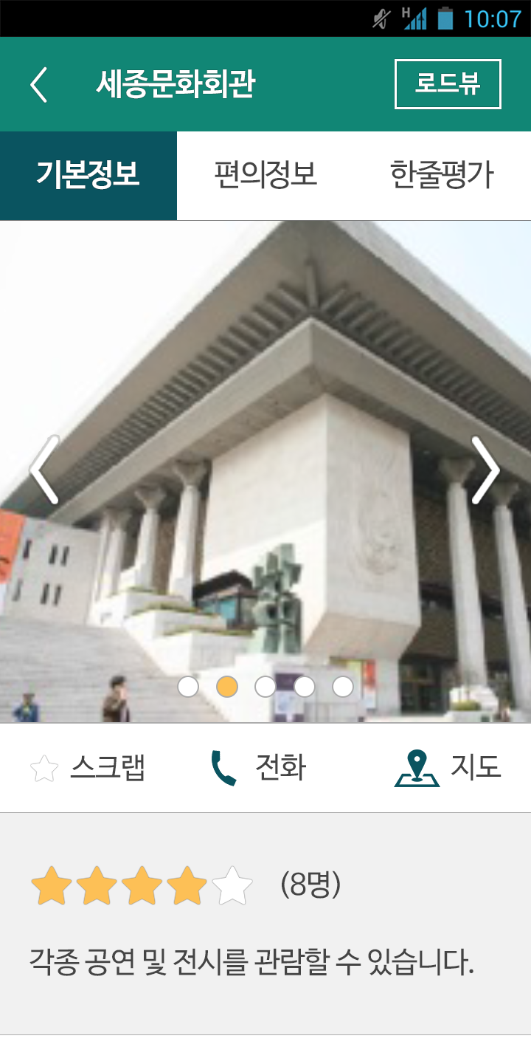
프로젝트명 | 중구길벗 | 페이지명 | area_store_detail1 | 지역>업체>기본정보
생성자/수정자 | 기획팀 | 최초작성일 | 2015.08.29 | 최종수정일
1
2
11
Description
It goes back when touched – (Important) Go back in the same way. The name of a company It changes the current screen to the detailed basic information of the relevant company when touched. – [area_store_detail1] It changes the current screen to the detailed convenience information of the relevant company when touched. – [area_store_detail2] It changes the current screen to the detailed one-line review of the relevant company when touched. – [area_store_detail3] Slide over sideways to see other pictures of the relevant company Clip button - It sends an alert window “Log on to My Page” if touched when not logged in. - Clip button changes the color and the relevant information gets clipped if touched when logged in. - The color already has changed for the clipped companies and touching the Clip button with changed color inactivates the Clip action and the color goes back to normal. It makes a call at the phone number of the relevant company. See the location of the relevant company on a map. - [area_store_detail1_map] Brief introduction, a star-grade, detailed information (address/telephone number/service hours/budget/parking/holidays), transportation and directions, and a homepage are displayed. Road View button - Touching this button runs Naver Map and shows the relevant pin selected on it. It is for activating Road View immediately after touching Road View button on the current screen. - In case of a device without Naver Map, it runs Google Play and sends a download screen to install Naver Map. Continued in the next page
3
4
5
6
7
8
9
10

Slide 7
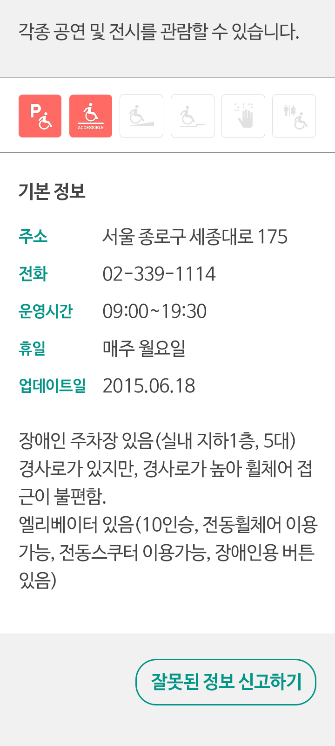
프로젝트명 | 중구길벗 | 페이지명 | area_store_detail1 | 지역>업체>기본정보
생성자/수정자 | 기획팀 | 최초작성일 | 2015.08.29 | 최종수정일
Description
Address(주소) Number service hours(운영시간) holidays(휴일) Date of the latest update(업데이트일) Show Building form, Floor, Facility type, and other information. Show tags A pop-up window comes on when touched. – [report-pop-up]
1
2
3
4
5
6
세부정보
7
문화시설
랜드마크
광화문
세종
뮤지컬
문화
유명지
8

Slide 8
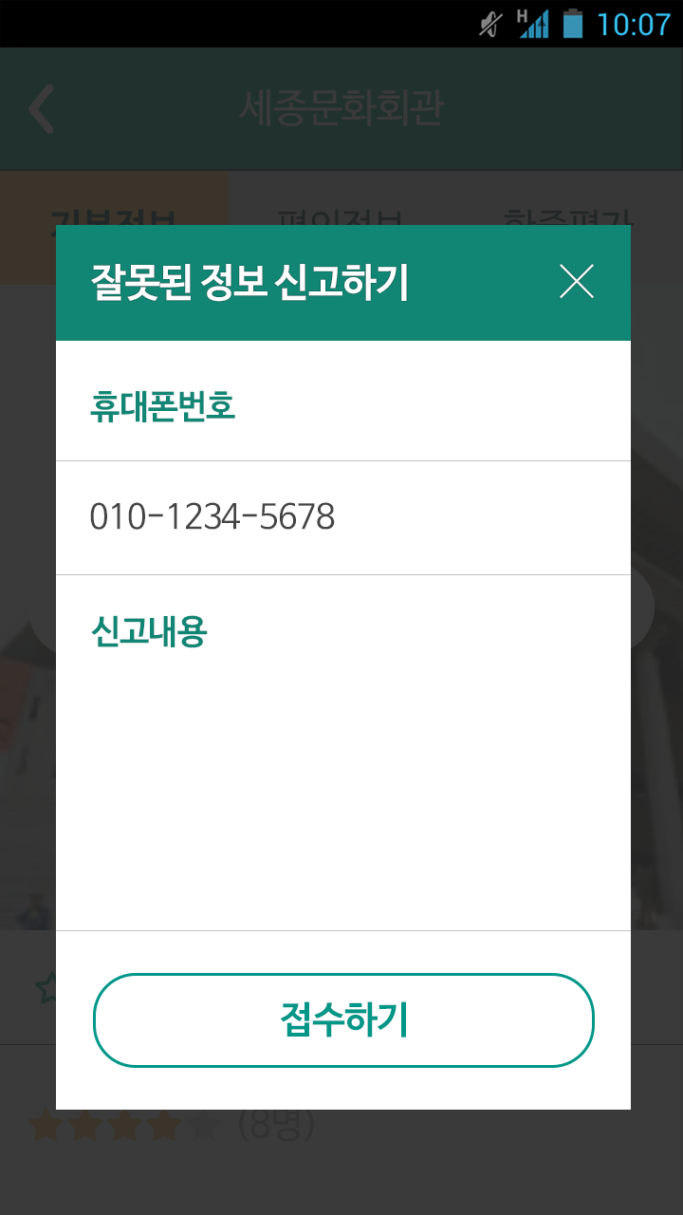


프로젝트명 | 중구길벗 | 페이지명 | report-pop-up | 지역>업체>기본정보
생성자/수정자 | 기획팀 | 최초작성일 | 2015.08.29 | 최종수정일
Description
A window for entering a mobile phone number A window for entering the details of a report Report button (activated regardless of login status) - An alert window pops up if a mobile phone number and the details of a report have not been entered. (“Enter all information”) - An alert window pops up if not agreed to the Policy on the Treatment of Personal Information. (“Agree to the Policy on the Treatment of Personal Information”) - Once all information is filled in, the details of a report are sent to the Administrator page when touched and a notice window pops up (“Your report has been received successfully”) - Touching Confirm button in the notice window closes the pop-up window. Agree to the Policy on the Treatment of Personal Information button is added. Touching Send button registers the name, an address, and a telephone number of the relevant company and report details and a contact number of the reporter in a modification request table in DB and it is composed as the representative email address of the center. (센터 대표메일로 조성되게 함)
1
2
4
3

Slide 9
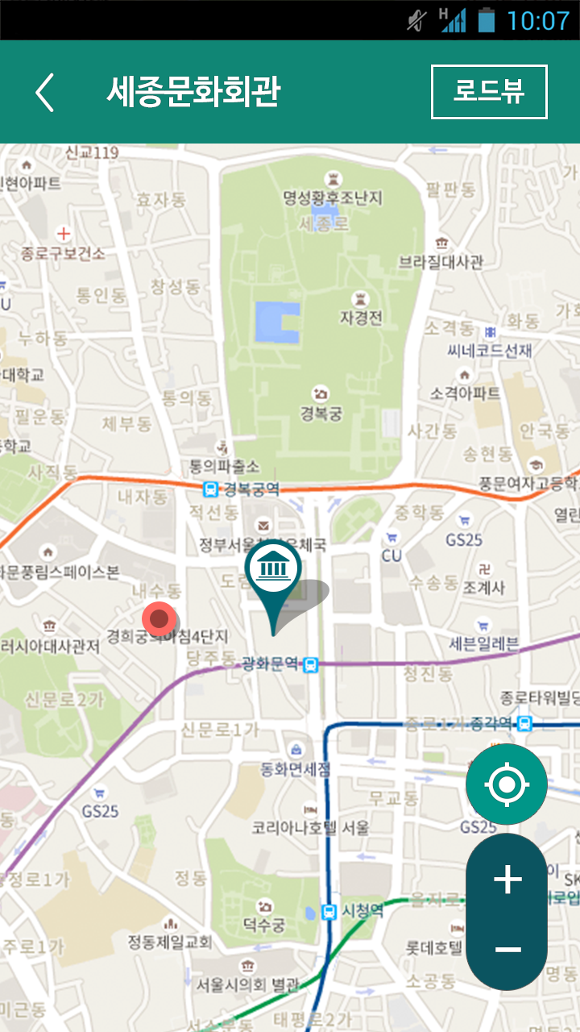
프로젝트명 | 중구길벗 | 페이지명 | area_store_detail1_map | 지역>업체>기본정보>지도
생성자/수정자 | 기획팀 | 최초작성일 | 2015.08.29 | 최종수정일
1
2
4
Description
It goes back when touched. – [area_store_detail1] The name of a company A map only with a pin of the relevant company exposed Road View button - Touching this button runs Naver Map and shows the relevant pin selected on it. It is for activating Road View immediately after touching Road View button on the current screen. - In case of a device without Naver Map, it runs Google Play and sends a download screen to install Naver Map.
3

Slide 10
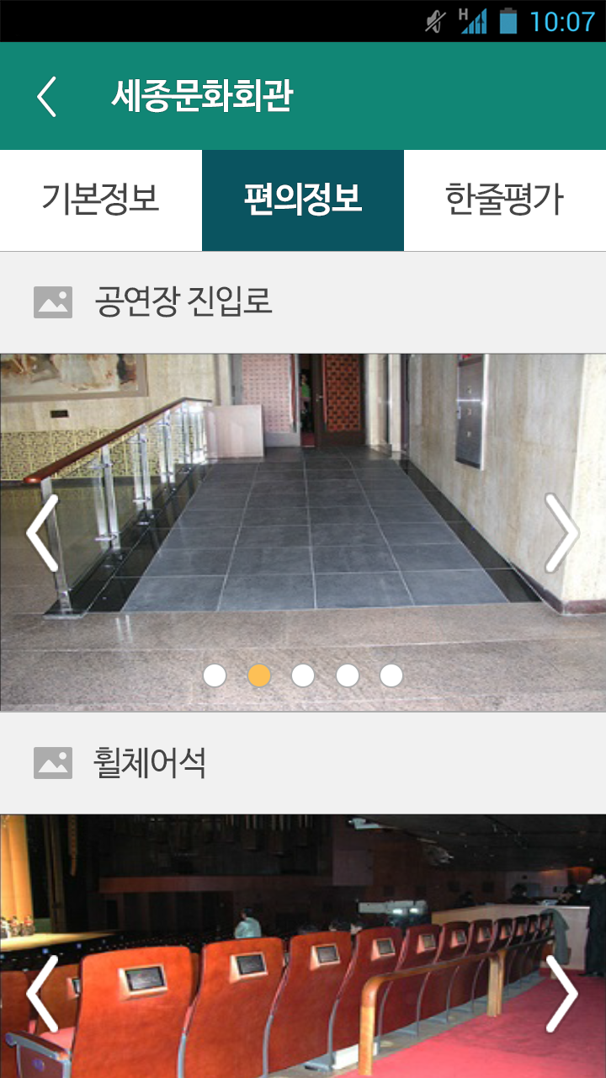
프로젝트명 | 중구길벗 | 페이지명 | area_store_detail2 | 지역>업체>편의정보
생성자/수정자 | 기획팀 | 최초작성일 | 2015.08.29 | 최종수정일
Description
- It shows the related pictures of each item. - Pictures of a company, Check other pictures by touching left/right arrow.
1

Slide 11
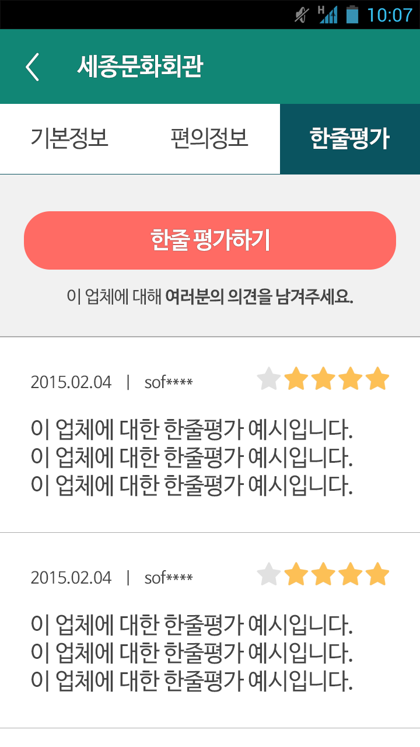
프로젝트명 | 중구길벗 | 페이지명 | area_store_detail3 | 지역>업체>한줄평가
생성자/수정자 | 기획팀 | 최초작성일 | 2015.08.29 | 최종수정일
Description
- It sends an alert window “Log on to My Page” if touched when not logged in. - If touched when logged in, it changes the current page to the Write page. – [area_store_detail3_create] - It shows the latest grades, the number of evaluators, and each one-line review. - 10 reviews are exposed and another 10 are exposed when the scroll bar reaches the bottom.
1
2

Slide 12
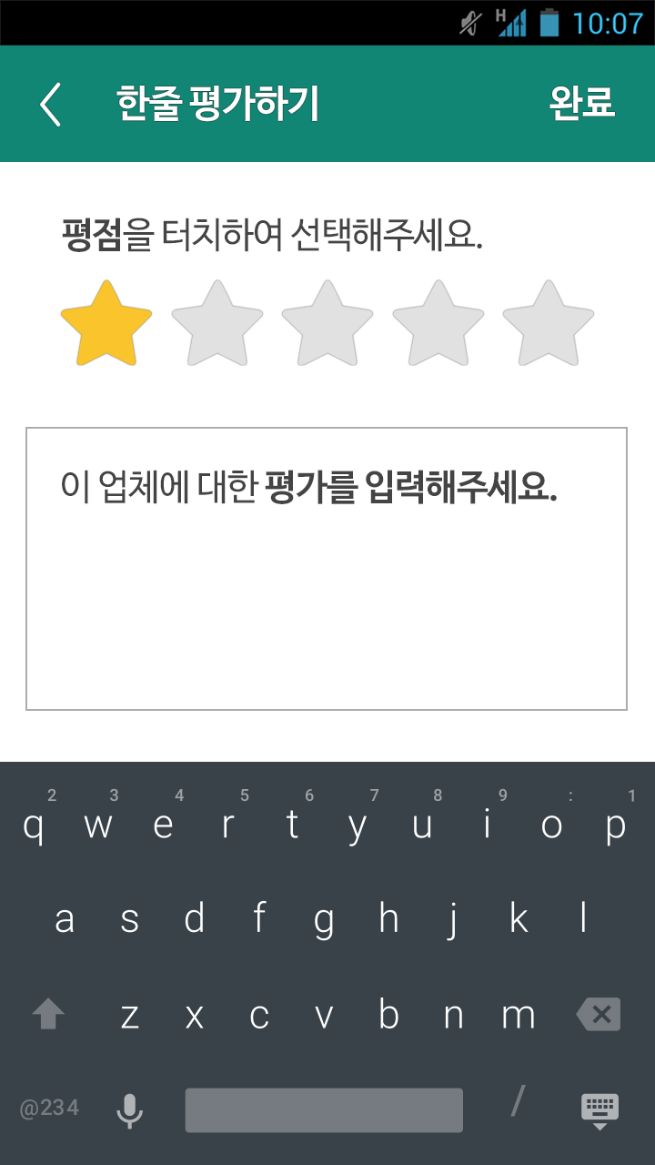
프로젝트명 | 중구길벗 | 페이지명 | area_store_detail3>create | 지역>업체>한줄평가>작성
생성자/수정자 | 기획팀 | 최초작성일 | 2015.08.29 | 최종수정일
1
Description
It goes back when touched. – [area_store_detail3] Grades can be changed by touching. A box for entering one-line review A keypad is fixed at the bottom. Complete button - An alert window pops up if touching the button while either a grade or a review is not completely entered. – “Enter a grade and a review completely” - If all items are entered, touching the button after entering the relevant information moves the current screen to the one-line review screen. – [area_store_detail3]
5
2
3
4

Slide 13
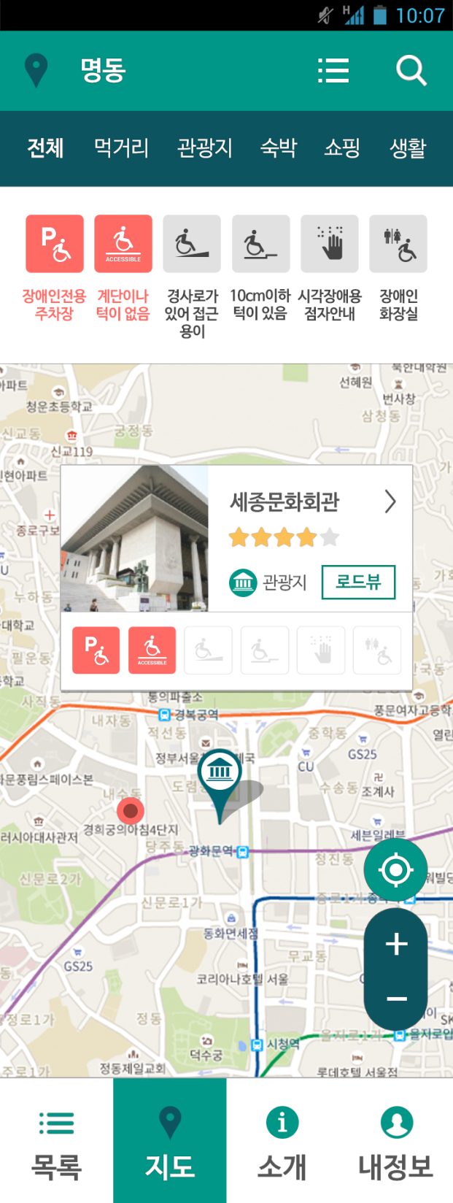
프로젝트명 | 중구길벗 | 페이지명 | map | 지도
생성자/수정자 | 기획팀 | 최초작성일 | 2015.08.29 | 최종수정일
1
Description
Select Region button. Default setting sends a pop-up window for region selection when touching Jung-gu. Category selection menu. Only the pins of the relevant category are displayed below when touched. - Default setting displays every icon blurrily. All contents are displayed as a pin on a map at this state. - Touching a specific icon makes the relevant text and icon bold and only the pins including all bold lettered accessibility information are exposed. (AND concept) Current Location button. Touching this button changes the location to the current location and displays the current location as a dot. Touching each pin displays the information of the relevant company. Touching the company information, except Road View button, shows the detailed information of the relevant company. - [area_store_detail1] Enlarge/Reduce Map (Map can be enlarged and reduced by gathering and spreading two fingers) Road View button - Touching this button runs Naver Map and shows the relevant pin selected on it. It is for activating Road View immediately after touching Road View button on the current screen. - In case of a device without Naver Map, it runs Google Play and sends a download screen to install Naver Map.
2
3
5
7
4
6

Slide 14
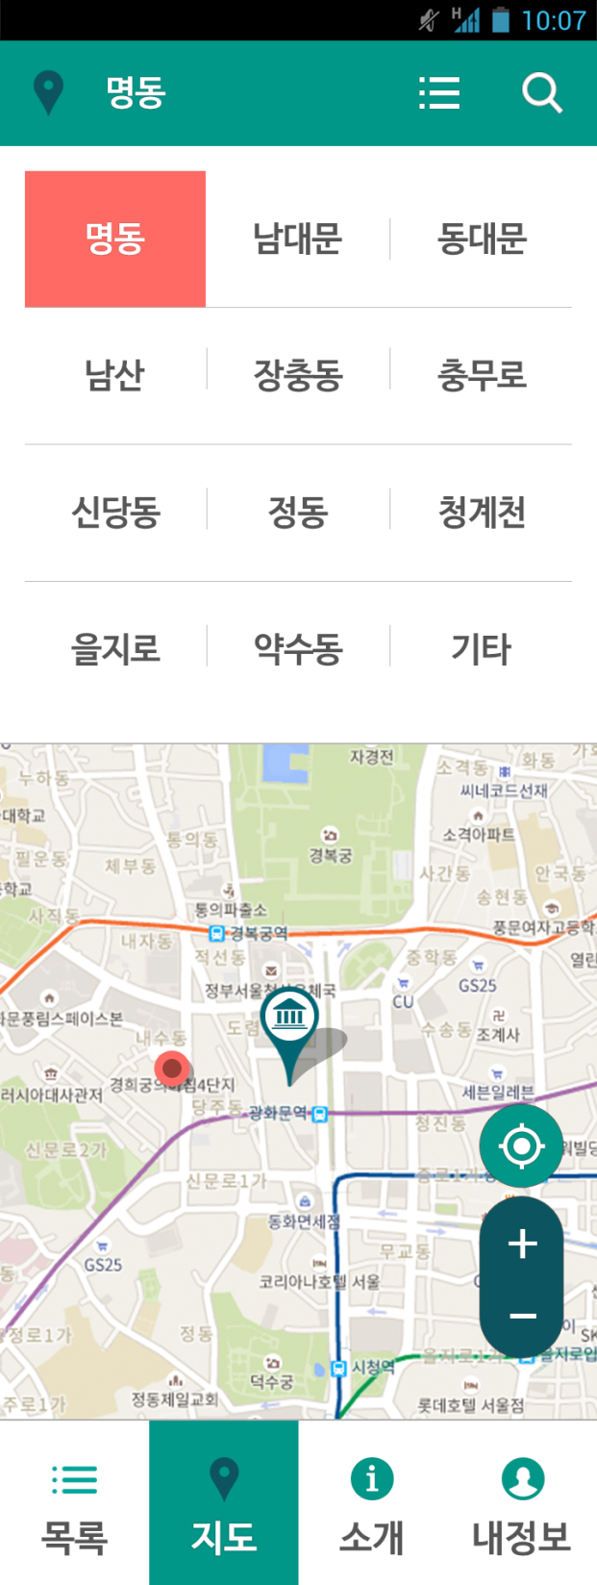
프로젝트명 | 중구길벗 | 페이지명 | map_category | 지역선택팝업
생성자/수정자 | 기획팀 | 최초작성일 | 2015.08.29 | 최종수정일
Description
When user selects a desired region from a pop-up window, the pop-up window disappears.
1

Slide 15

프로젝트명 | 중구길벗 | 페이지명 | intro | 소개
생성자/수정자 | 기획팀 | 최초작성일 | 2015.08.29 | 최종수정일
Description
Necessity of contents - Introduction of Jung-gu Gilbut Disabled Self-support Center - Homepage address
LOGO
길벗 소개 컨텐츠
1
리스트
지도
길벗
소개
마이
페이지

Slide 16
프로젝트명 | 중구길벗 | 페이지명 | mypage | 마이페이지(비로그인)
생성자/수정자 | 기획팀 | 최초작성일 | 2015.08.29 | 최종수정일
Description
My Page when not logged in The screen changes to a Log In screen when touched. – [mypage_login] The screen changes to a Member Join screen when touched. – [mypage_join] The screen changes to a Notice screen when touched. – [mypage_notice] The screen changes to a Setting screen when touched. – [mypage_setting]
LOGO
1
로그인
2
회원가입
3
공지사항
4
설정
리스트
지도
길벗
소개
마이
페이지

Slide 17
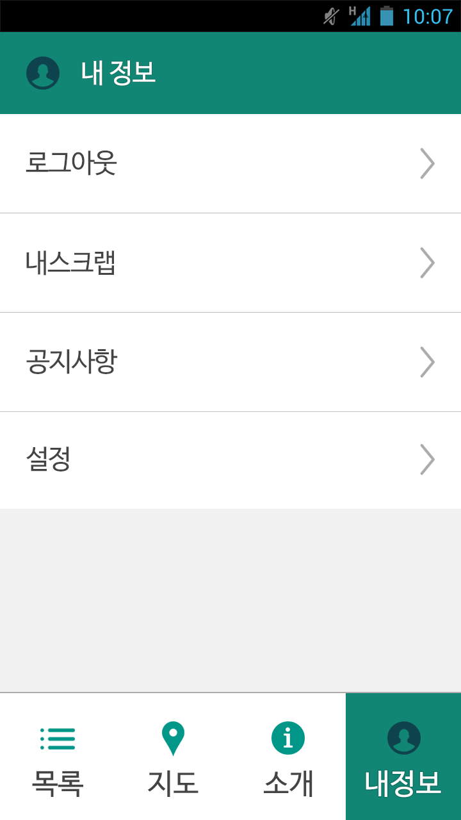
프로젝트명 | 중구길벗 | 페이지명 | mypage | 마이페이지(로그인)
생성자/수정자 | 기획팀 | 최초작성일 | 2015.08.29 | 최종수정일
Description
My Page after logging in It displays My Page when not logged in after logging out the page when touched. – [mypage] The screen changes to a My Scrap screen when touched. – [mypage_scrap] The screen changes to a Notice screen when touched. – [mypage_notice] The screen changes to a Setting screen when touched. – [mypage_setting]
1
2
3
4

Slide 18
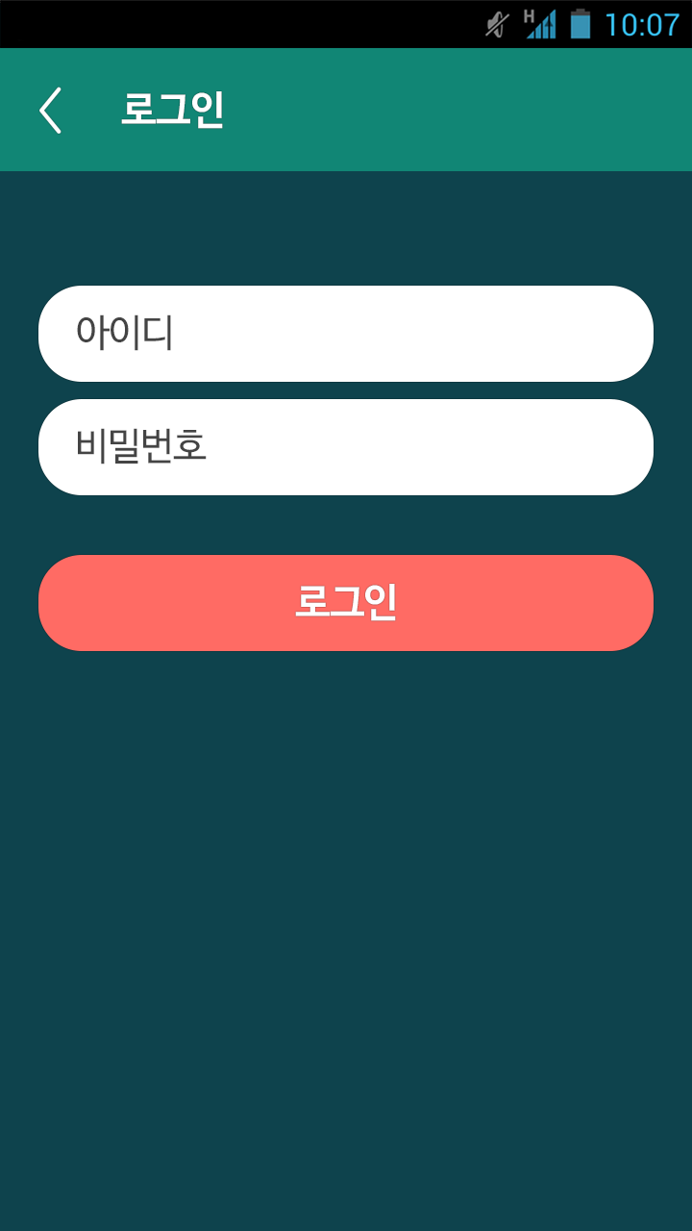
프로젝트명 | 중구길벗 | 페이지명 | mypage_login | 마이페이지>로그인
생성자/수정자 | 기획팀 | 최초작성일 | 2015.08.29 | 최종수정일
1
Description
It goes back when touched. – My Page when not logged in – [mypage] A box for entering an ID address. It hides “ID” as entered. A box for entering a password. It hides “Password Address” as entered. - If ID and PW are incorrect, an alert window pops up. (“Confirm your ID and PW once again.”) - If ID and PW are correct, it allows user to log in and goes to My Page. - [mypage] - Once user is logged in, the system has the user stay logged in automatically.
2
3
4

Slide 19
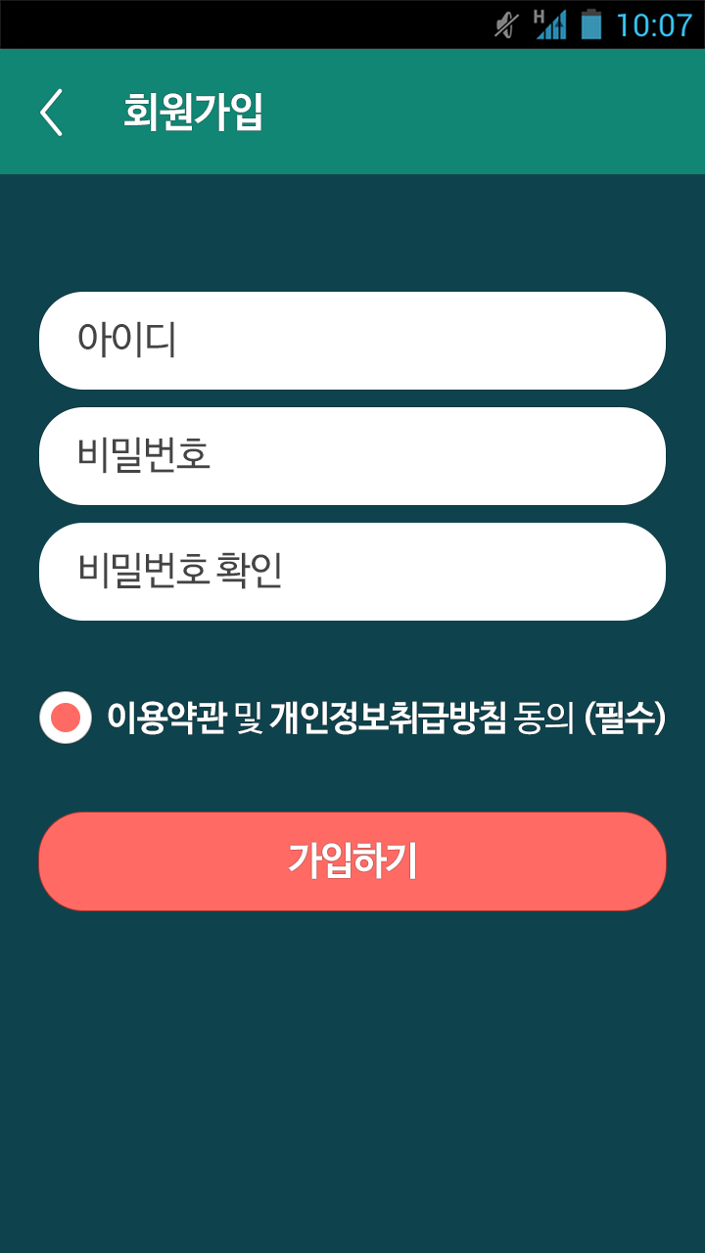
프로젝트명 | 중구길벗 | 페이지명 | mypage_join | 마이페이지>회원가입
생성자/수정자 | 기획팀 | 최초작성일 | 2015.08.29 | 최종수정일
1
Description
It goes back when touched. – My Page when not logged in – [mypage] A box for entering an ID address. It hides “ID” as entered. A box for entering a password. It hides “Password Address” as entered. A box for confirming a password. It hides “Password Confirmation” as entered. Check box - A link is inserted for “User’s Agreement” and “Policy on the Treatment of Personal Information” - Selecting User’s Agreement displays User’s Agreement on a new window. - Selecting Policy on the Treatment of Personal Information displays Policy on the Treatment of Personal Information on a new window. - Join button - If ID, Password, and Password Confirmation are not completely filled in, an alert window pops up. (“Enter both ID and PW.”) - If User’s Agreement has not been checked, an alert window pops up. (“Agree to User’s Agreement”) - If there are any other problems, a window that confirms that the user has successfully joined as a member (“You have become a member”) and the user is automatically logged in and the screen changes to My Page. - [mypage] - User gets to be logged in automatically once joined as a member, the user will stay logged in afterwards.
2
3
4
5
6

Slide 20
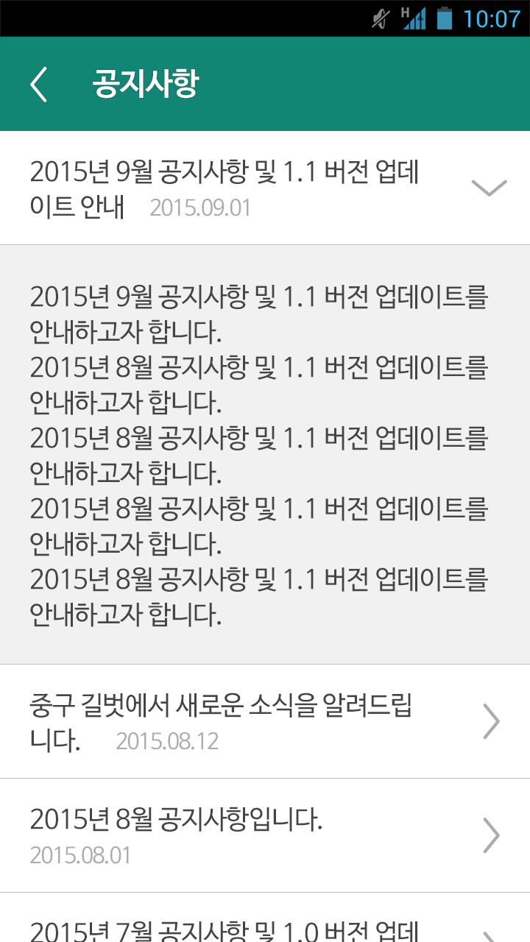
프로젝트명 | 중구길벗 | 페이지명 | mypage_notice | 마이페이지>공지사항
생성자/수정자 | 기획팀 | 최초작성일 | 2015.08.29 | 최종수정일
1
Description
It goes back when touched. – [mypage] Touch to unfold and fold.
2

Slide 21
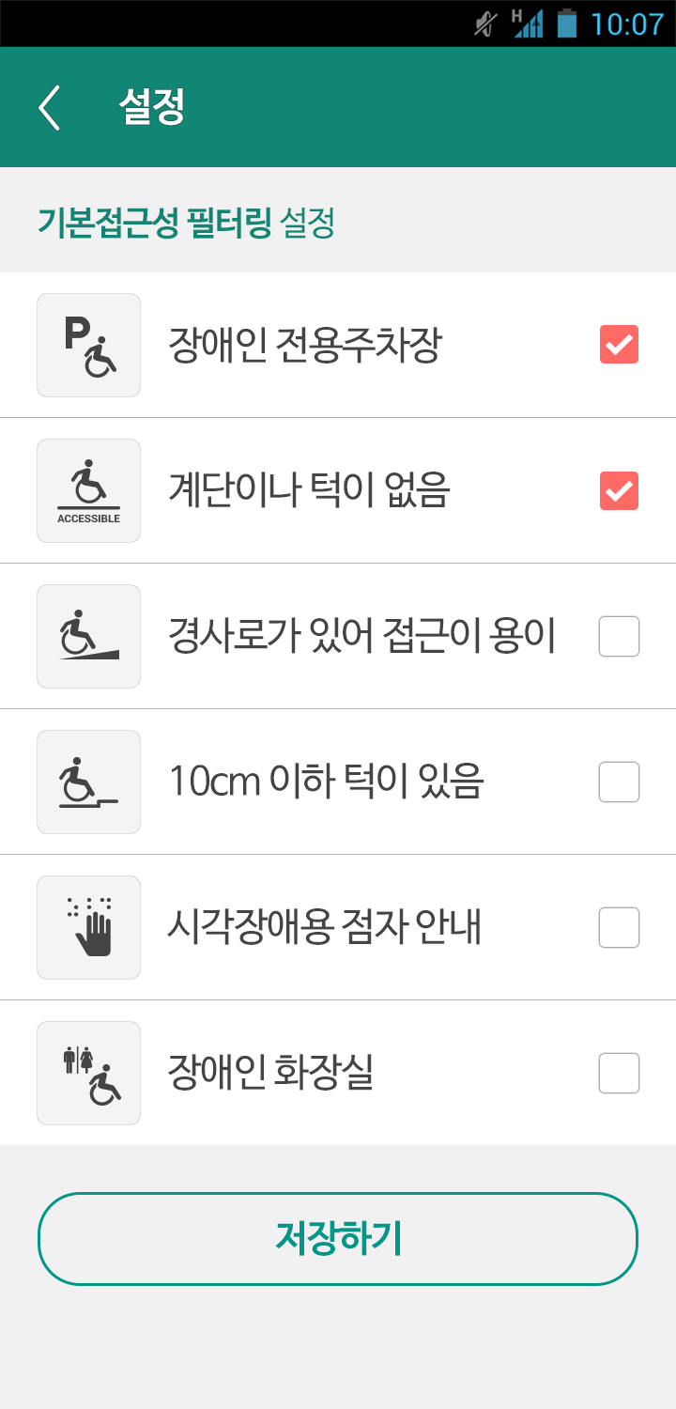
프로젝트명 | 중구길벗 | 페이지명 | mypage_setting | 마이페이지>설정
생성자/수정자 | 기획팀 | 최초작성일 | 2015.08.29 | 최종수정일
1
Description
It goes back when touched. – [mypage] Check box - Default is all checked. - If ticking specific boxes and saving such setting, the relevant filtering setting applies automatically on a List screen. Ticking either Sill Smaller Than 5cm or Sill that Needs an Assistant on the form is to be considered as having a sill smaller than 10cm. Save button Touching the button saves the setting and goes to My Page. – [mypage]
2
3
4

Slide 22
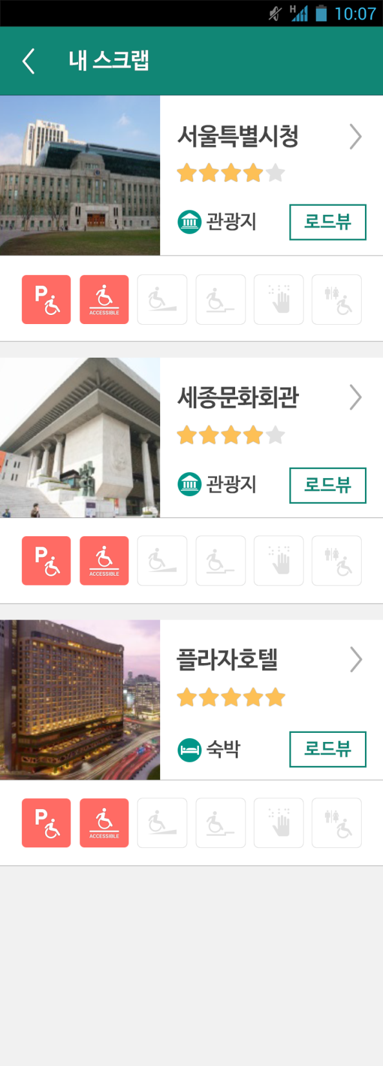
프로젝트명 | 중구길벗 | 페이지명 | mypage_scrap | 마이페이지>내 스크랩
생성자/수정자 | 기획팀 | 최초작성일 | 2015.08.29 | 최종수정일
1
Description
It goes back when touched. – [mypage] - A representative thumbnail image and the name of each company, a category icon, a star-grade, and an accessibility information icon are displayed. - Touching each item shows the detailed information of the relevant company. – [area_store_detail1] Road View button
2
3
3
3

Slide 23
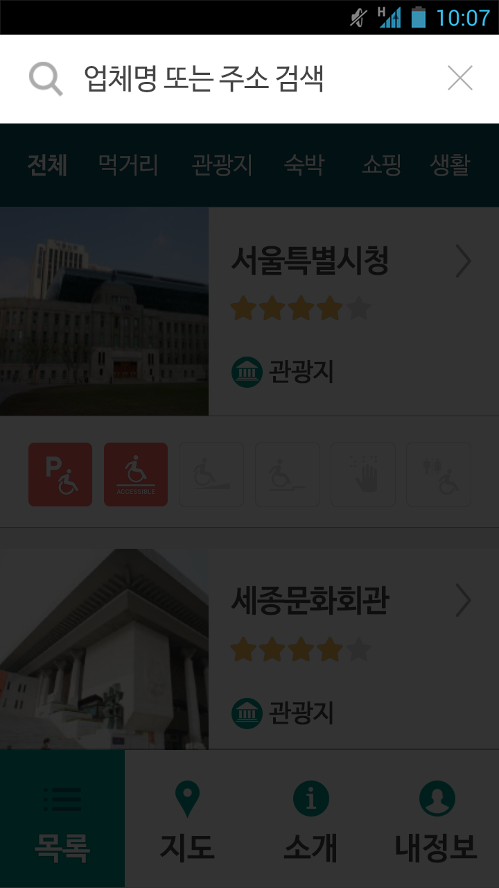


프로젝트명 | 중구길벗 | 페이지명 | search | 검색
생성자/수정자 | 기획팀 | 최초작성일 | 2015.08.29 | 최종수정일
1
2
Description
A window for entering the name and an address of a company - A search box is closed if touched without entering a word to search. - Touching after entering a search word starts searching with such keyword. – [search_result]

Slide 24
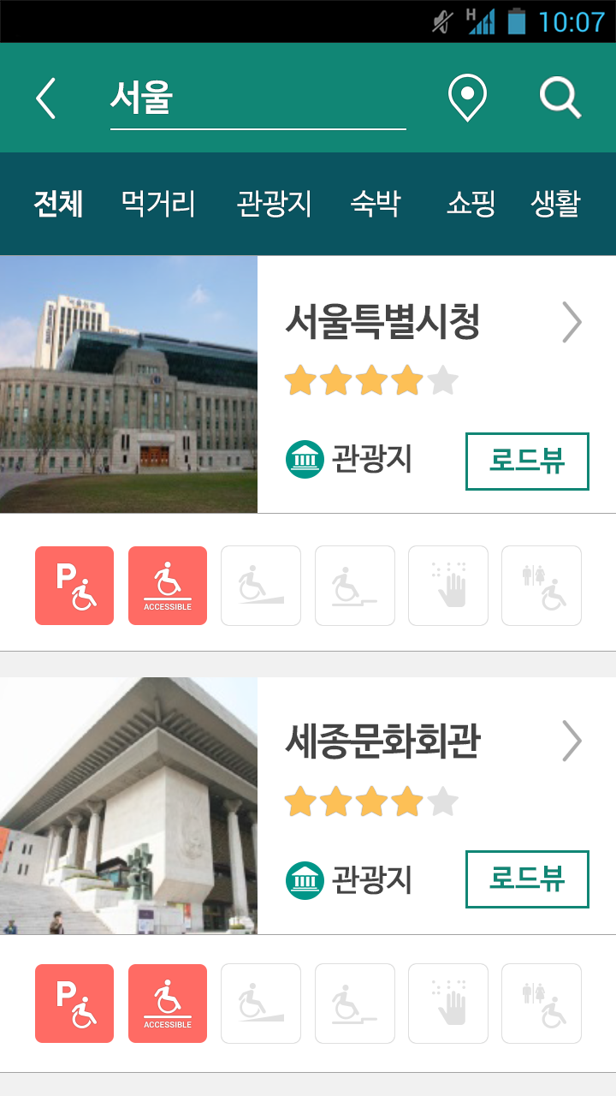
프로젝트명 | 중구길벗 | 페이지명 | search_result | 검색>검색결과
생성자/수정자 | 기획팀 | 최초작성일 | 2015.08.29 | 최종수정일
1
2
3
4
Description
It goes back when touched. A window for entering the name and an address of a company Map View button Touching this button displays the companies that have currently been searched on a map. – [search_result_map] - Touching after deleting the existing search word sends an alert window. – “Enter a search word.” - Touching after entering a search word starts searching with such keyword. – [search_result] Category selection menu. Only the contents of the relevant category are displayed below when touched. - 10 results are exposed and another 10 are exposed when the scroll bar reaches the bottom. - The nearest companies to the current location are exposed first. - A representative thumbnail image and the name of each company, a category icon, a star-grade, and an accessibility information icon are displayed. - Touching each item shows the detailed information of the relevant company. – [area_store_detail1] Road View button
5
6
7
7

Slide 25
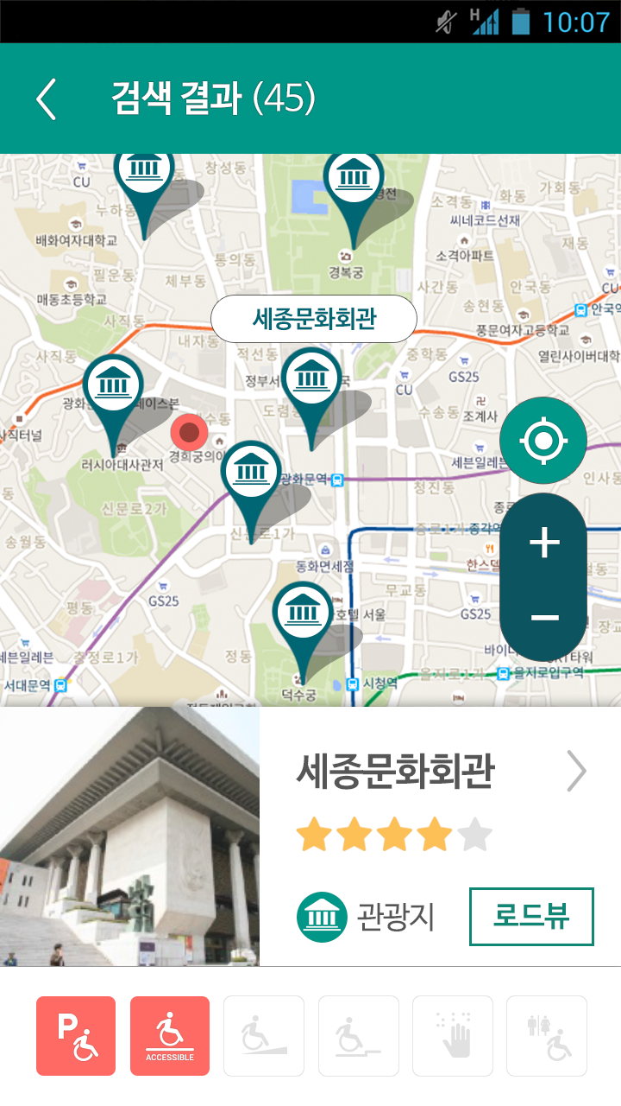
프로젝트명 | 중구길벗 | 페이지명 | search_result_map | 검색>검색결과>지도
생성자/수정자 | 기획팀 | 최초작성일 | 2015.08.29 | 최종수정일
1
2
Description
It goes back when touched. – [search_result] - The number of companies searched before touching Map View are displayed in brackets. Touching Map View adjusts the map to have all searched companies displayed as a pin on one screen. - Touching each pin shows the name of the relevant company on it. - Default displays the contents exposed at the top when touching Map View. - Touching the name of each company shows the detailed information of the relevant company. - [area_store_detail1] - Touching each pin displays a representative thumbnail image, the name, a category icon, a star-grade, and an accessibility information icon of each company at the bottom. - Default displays the contents exposed at the top when touching Map View. - Touching each item shows the detailed information of the relevant company. – [area_store_detail1] Road View button
3
4
5
6

